Slide 1
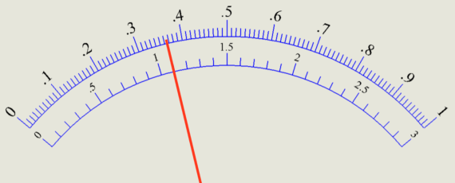
Reading an Ammeter Scale
Determine the range.
What is the current if we are using the
0-1 A scale?

Slide 2
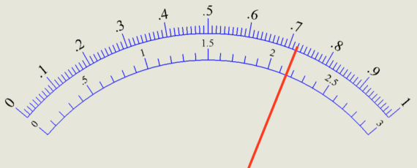
What is the current if we are using the
0-3 A scale?

Slide 3
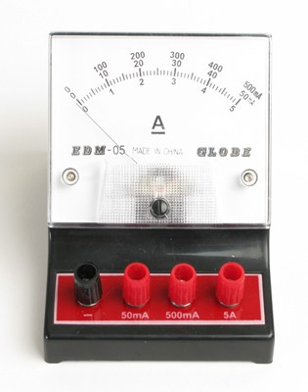
We will use the 0-50 mA scale for our Summative Task.

Slide 4
Activity 1:
Hook up the hand crank generator to the black and red terminals of the ammeter.
Turn the crank to create a steady current.
See if you can generate a 100 mA current steadily or a 0.100 A current steadily.
Let all members of your group try!

